Slide 2
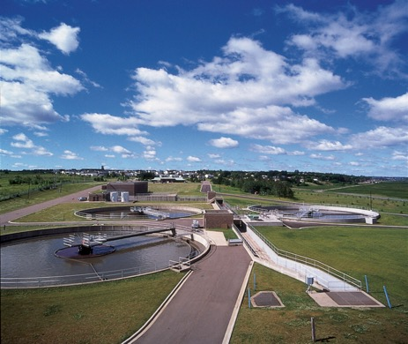
TransAqua
Commissioner Orientation
December 31, 2018

Slide 3
Presentation Overview
Wastewater Treatment Process
WWTF Upgrade and Modernization Project Update
Biosolids Process
Compost Testing and Quality Standards
Giving back to the Community
Carbon Footprint
Takeaways!

Slide 4
History

Slide 5
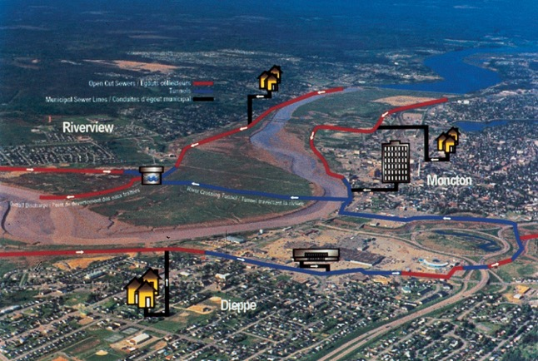
Collection System

Slide 6
Collection System
Whether at home, at school or at the office, everyone contributes to the flow of wastewater. Domestic sources include bathing, washing, flushing toilets, dishwashers, etc.

Slide 7
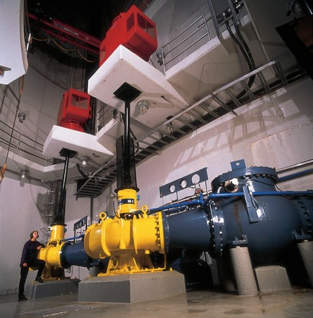
Main Pumping Station

Slide 8
Main Pumping Station
The sewage flows through a sewer system to the main pumping station where it enters the "receiving well", a concrete chamber that extends about 30 meters underground. From there, the wastewater is pumped into the pre-treatment facilities located in the Inlet Building where the treatment begins.

Slide 9
Septage Receiving
TransAqua receives all the septic tank and portable toilet waste from the region transported by local vacuum truck companies. The waste is monitored for pH, temperature and total solids.

Slide 10
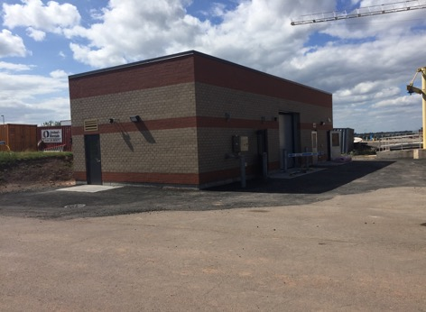
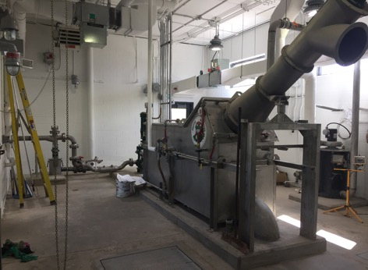
Septage Receiving

Slide 11
Bar Screens
Bar screens, located in pre-treatment facilities, remove all solid objects more than 6 millimeters in diameter (such as fabric objects, sticks, stones, plastic bags) from wastewater before they are treated. The old bar screens removed objects more than 20 millimetres. This waste is sent to the regional solid waste landfill.

Slide 12
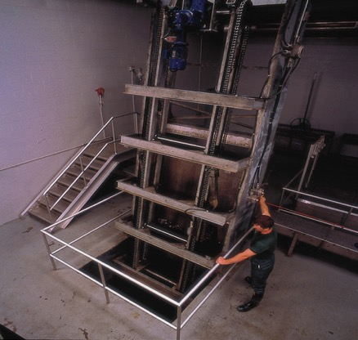
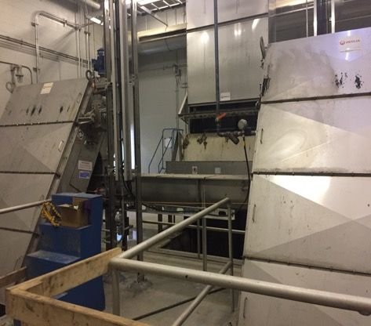
Bar Screens

Slide 13
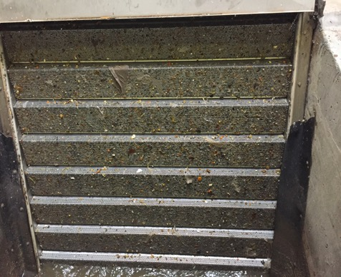
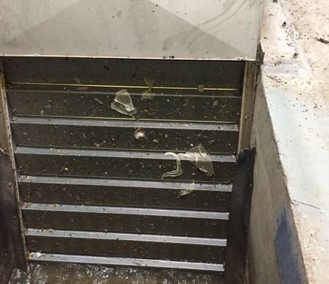
Bar Screens

Slide 14
Grit Removal
In the open-air grit removal tanks, located next to the pretreatment facilities, the sand as well as other heavy and non-biodegradable solid waste is separated from the wastewater. They are deposited in the bottom of the grit traps from which they are removed, washed and disposed of at the regional solid waste landfill.

Slide 15
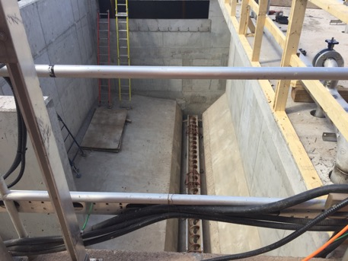
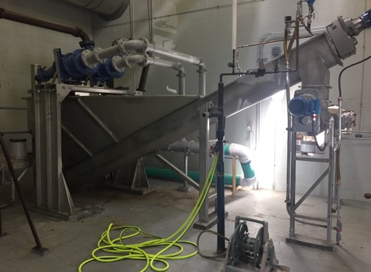
Grit Tanks

Slide 16
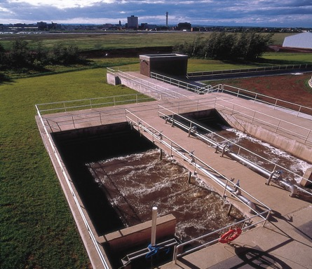
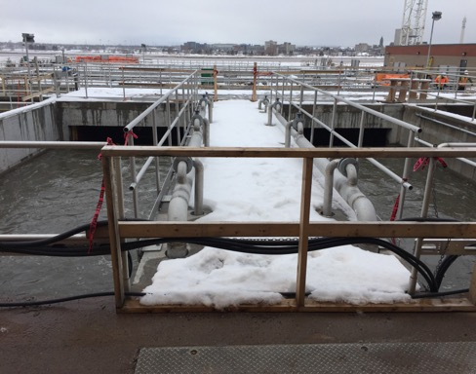
Grit Tanks

Slide 17
Primary Clarifiers
The addition of chemicals to the wastewater improves the natural settling action of suspended solids particles, which are then deposited at the bottom of three circular settling basins or clarifiers. The particles are collected and removed from the bottom of the ponds in the form of wet, thick sludge while the treated water empties over weirs at the top into the discharge pipe that flows into the river.

Slide 18
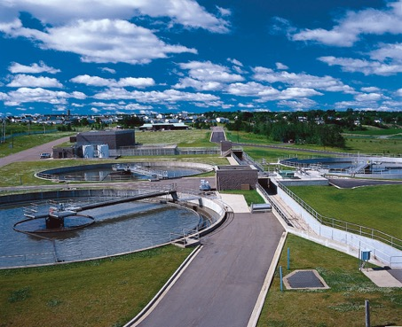
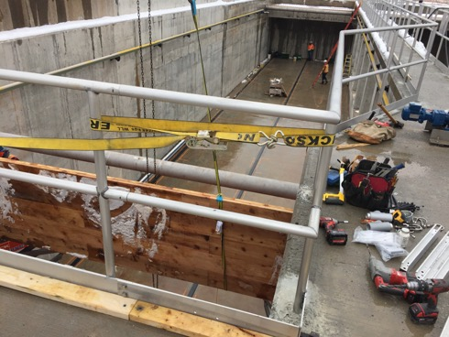
Primary Clarifiers

Slide 19
Bioreactor
The bioreactor will contain bugs that eat the waste. They need oxygen to be happy, healthy and hungry! The bioreactor is key to removing nitrogen, phosphorus (blue-green algae blooms) and biochemical oxygen demand to meet federal regulations by the end of 2020. BOD is the measure of how much oxygen is available in the effluent to aquatic life in the Petitcodiac River.

Slide 20
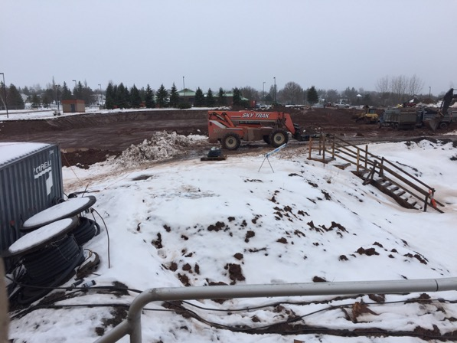
Bioreactor

Slide 21
Secondary Clarifiers
Secondary clarifiers allow for more solids to settle to the bottom that can be removed for dewatering. This is a key element to TransAqua meeting federal regulations by the end of 202 for TSS.

Slide 22
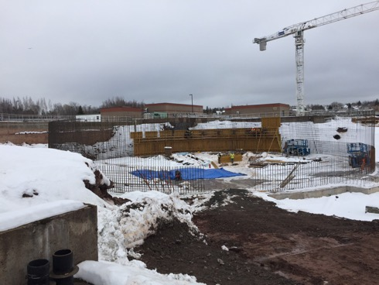
Secondary Clarifiers

Slide 23
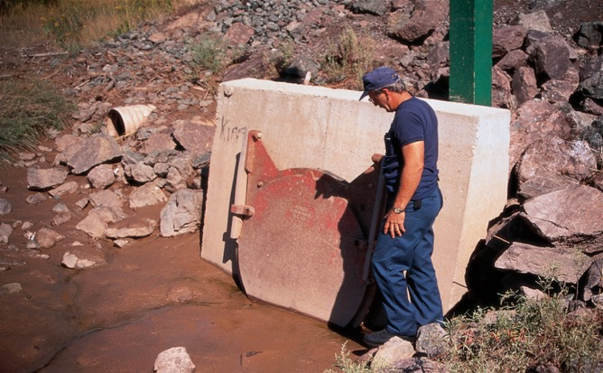
Effluent Pipe

Slide 24
Sludge Handling
Sludge from the Primary Clarifiers and a different type of sludge from the Secondary Clarifiers is pumped into different tanks and mixed to ensure the appropriate ratio required for optimal dewatering. Some sludge will be recycled to the bioreactor to ensure enough biomass is available to break down the waste

Slide 25
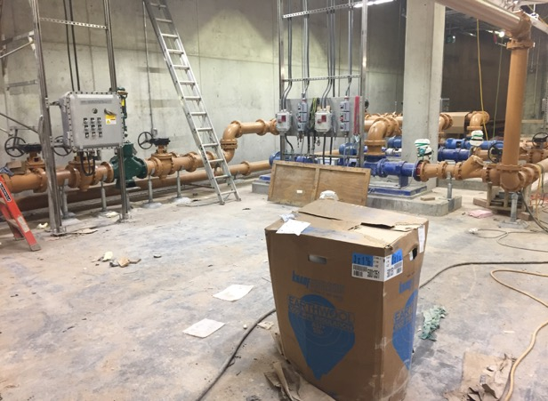
Sludge Handling

Slide 26
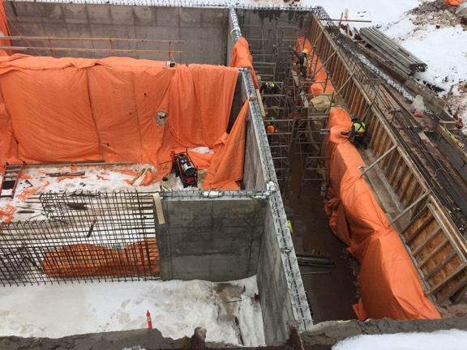
Sludge Handling

Slide 27
Centrifuges
Liquid sludge is pumped to the dewatering building where polymer is added to coagulate the fine solids Centrifuges are used to increase the dryness of the solids by removing water after spinning at a very fast pace.

Slide 28
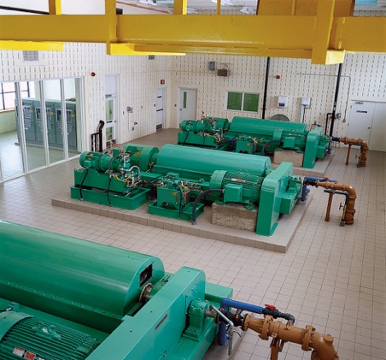
Centrifuges

Slide 29
Lime Stabilization
The lime stabilization process incorporates two 25-tonne lime storage silos, a transfer system, a volumetric doser and a blender mixer. The lime slurry is mixed with the sludge before being dewatered to control odors and improve dewatering. Lime is again added after dewatering in solid form using the volumetric feed device and a kneader mixer to increase the pH for the composting process.

Slide 30
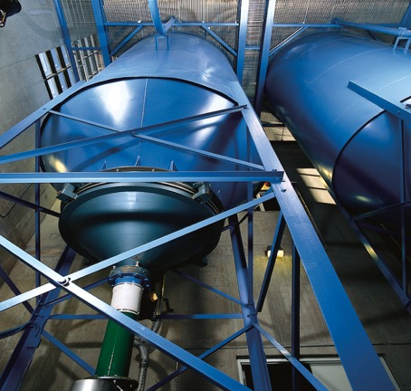
Lime Stabilization

Slide 31
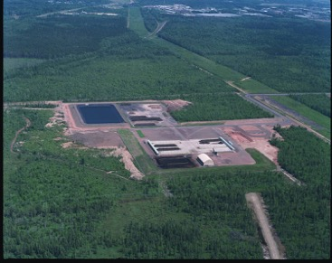
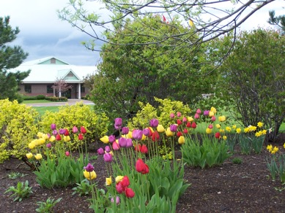
Biosolids Process

Slide 32
Biosolids Process
By-products generated by the treatment processes are primarily organic in nature and once processed for reuse are called "biosolids". Stabilization with lime makes these byproducts suitable for use as a soil additive in agriculture, in accordance with provincial guidelines. By-product composting is used in landscaping and topsoil manufacturing.

Slide 33
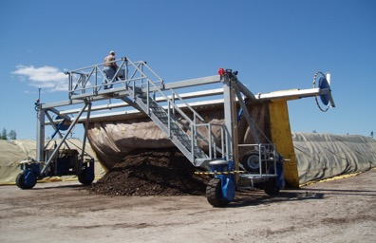
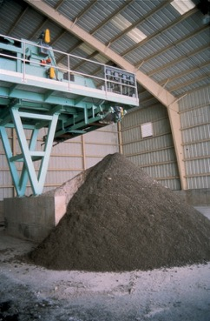
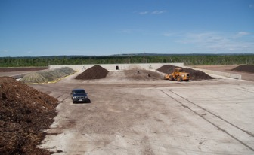
Biosolids Process

Slide 34
Compost Testing and Quality Standards
Trace elements | July 2016 GMWC Compost (mg/kg dry weight) | Type A Compost (BNQ) Maximum concentration within product (mg/kg dry weight) basis | Category A (CCME) Maximum concentration within product (mg/kg dry weight)
Arsenic (As) | 1.91 | 13 | 13
Cadmium (Cd) | B.D.L. | 3 | 3
Cobalt (Co) | 4.1 | 34 | 34
Chromium (Cr) | 20.35 | 210 | 210
Copper (Cu) | 102.25 | 400 | 400
Mercury (Hg) | 0.32 | 0.8 | 0.8
Molybdenum (Mo) | 3.3 | 5 | 5
Nickel (Ni) | 10.29 | 62 | 62
Lead (Pb) | 17.76 | 150 | 150
Selenium (Se) | B.D.L. | 2 | 2
Zinc (Zn) | 235.20 | 700 | 700
Additional laboratory data can be provided upon request

Slide 35
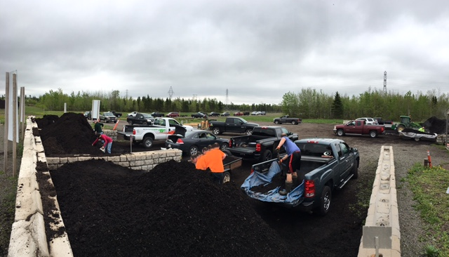
Giving Back to the Community!

Slide 36
Giving Back to the Community!
In 2016, TransAqua developed a new compost brochure for the public
TransAqua does not currently advertise ‘free’ compost in the community. It is mainly ‘word of mouth’ that has gained confidence in our compost
Compost is ‘free’ to the public who wish to load their own vehicles, $15 for TransAqua staff to use a bucket to load pickup trucks and trailers and $15/yard for commercial customers
Municipalities currently receive compost for free

Slide 37
Historical Community Compost Demand
Compost Clientele | 2012 | 2013 | 2014 | 2015 | 2016 | 2017
Public pick-up bins | 2,880 | 4,000 | 3,696 | 4,000 | 5,750 | 5,000
Commercial users | 280 | 515 | 160 | 960 | 1,000 | 1,000
City of Moncton | 1,464 | 42 | 535 | 800 | 40 | 130
City of Dieppe | 192 | 1,009 | 26 | 200 | 60 | 60
Town of Riverview | 128 | 16 | 34 | 96 | 150 | 60
Community projects | 128 | 128 | 24 | 400 | 200 | 200
Trials/tests/promotional | 360 | 680 | 600 | 400 | 200 | 150
Miscellaneous/TransAqua | 320 | 400 | 400 | 400 | 200 | 200
Annual compost output totals | 5,752 | 6,790 | 5,476 | 7,256 | 7,600 | 7,400
End of Season Inventory |  |  |  | 1,750 | 100 | 3,000

Slide 38
TransAqua’s Carbon Footprint
Greater Moncton Wastewater Commission
Greenhouse Gas Emissions Study
 | GHG Emissions
 | kt CO2 eq
Description | 2014 | 2015 | 2016
Process
Liquid Discharge | 0.13 | 0.14 | 0.13
Composting Process | 0.18 | 0.17 | 0.18
Total Process | 0.32 | 0.31 | 0.30
Collection | 1.18 | 1.07 | 1.05
Liquid Treatment | 0.71 | 0.70 | 0.75
Solids treatment | 0.59 | 0.61 | 0.59
Total Operations & Maintenance | 2.48 | 2.38 | 2.38
Total Emissions | 2.79 | 2.69 | 2.69
Credits
Potential Water Retention | 0.02 | 0.02 | 0.02
Carbon Sequestration | 0.77 | 0.81 | 0.79
Fertilizer off-set credits | 1.10 | 1.16 | 1.15
Total Credits (kt CO₂ eq)/year | 1.89 | 1.99 | 1.96
Net emissions GMWC (kt CO₂ eq)/year | 0.90 | 0.70 | 0.73
Beginning in 2021 with the wastewater treatment upgrade from primary to secondary treatment, more electricity and fuel will be required along with the increased production of biosolids for composting. The carbon footprint is expected to look like this;
4.335 – 2.034 = 2.301kt CO₂ eq / year
The composting facility currently reduces our carbon footprint by 68% that will be 53% in 2021.

Slide 39
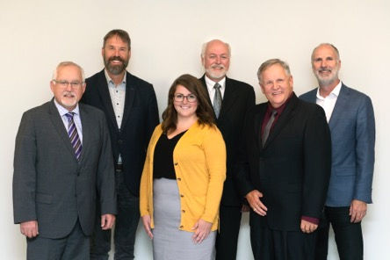
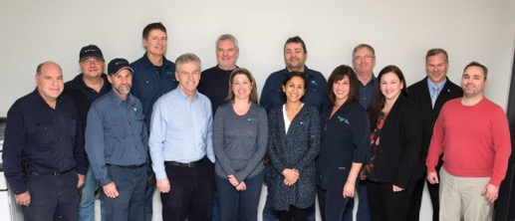
Thank You / Merci from the Commission and Staff

Slide 40
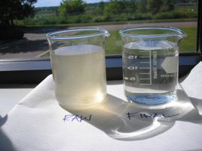
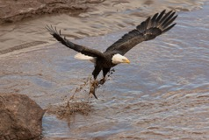
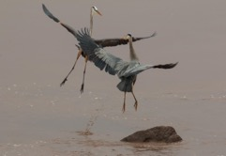
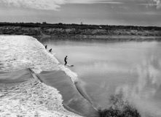
Questions?
Photography by Shawn Lee

